Slide 1

PROJECT #2
INSTAGRAM USER ANALYTICS
PAUL DAMEIN K

Slide 2
INTRODUCTION
Project Description:
I’m Paul Damein a data analyst working with the product team at Instagram.
My role involves analyzing user interactions and engagement with the Instagram app to provide valuable insights that can help the business grow.
Approach:
As a data analyse I’m going to extract the dataset, clean the data, check for errors, manipulate the errors and use the data to extract the necessary insights required by the desired audience.
Tech-Stack Used:
MySQL Workbench
Google Slides
I used SQL workbench for my project #2 because of it’s Speed, Simplicity & Accuracy. And I utilised Google slides to present to my desired audience as it is more presentable and easy to understand.
Insights:
Even though I’m proficient at using SQL. It gave a hands on experience with the scope of a data analyst in a product team setup.
Result:
In this project I’ve gained the knowledge of installing and setting up of MySQL on a mac OS. I was also able to understand the approach needed to be part of a product team as an analyst and understand the true the implications of analysis.
Drive Link:
https://docs.google.com/presentation/d/1uGnXff3zcxaEvCwPA-dF1O5Wj1yP2VUJ5Jfh5EqLRDQ/edit?usp=sharing

Slide 3
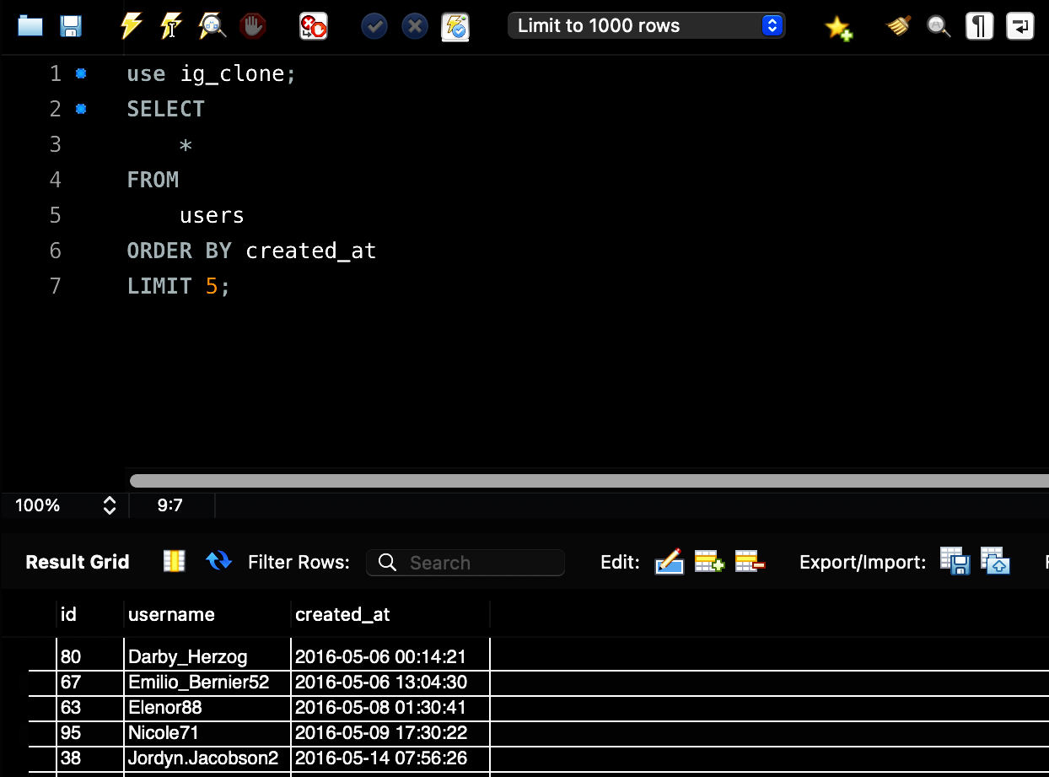
Marketing Analysis:
Task 1:Identify the five oldest users on Instagram from the provided database.
CODE:
SELECT
*
FROM
users
ORDER BY created_at
LIMIT 5;
Result: Output is the data of the top 5 oldest Instagram users.

Slide 4
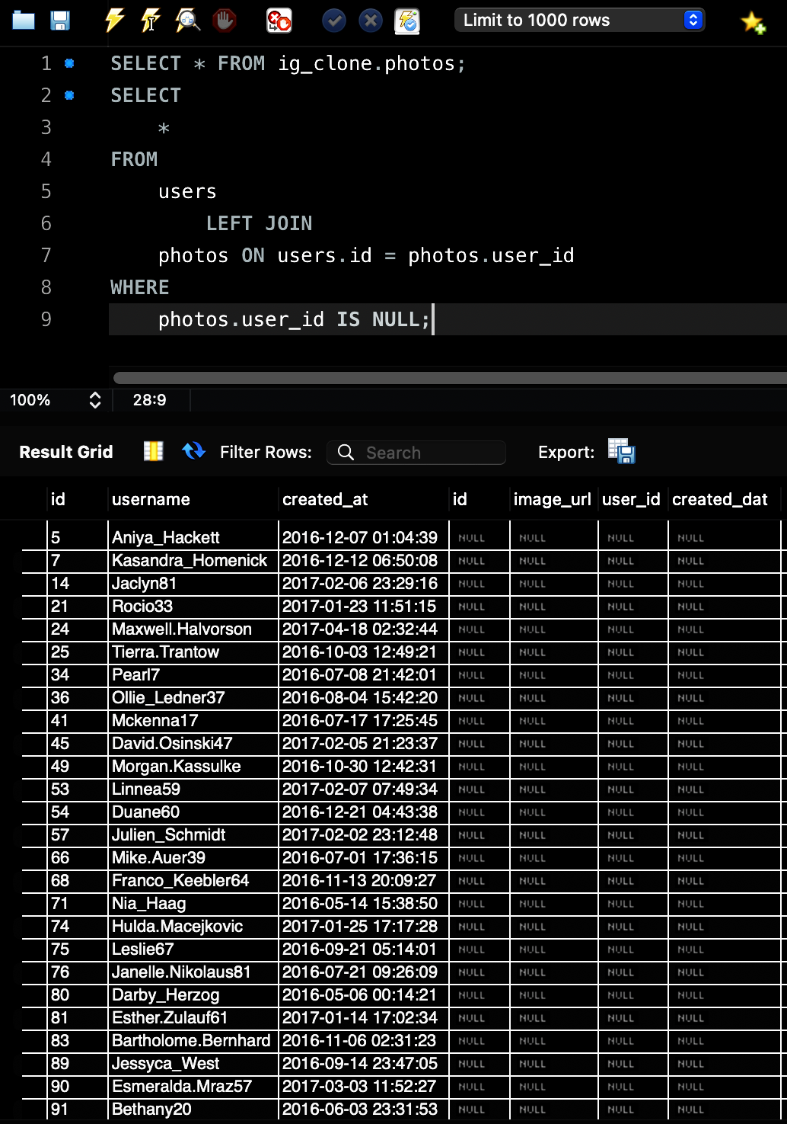
Task 2: Identify users who have never posted a single photo on Instagram.
CODE:
SELECT
*
FROM
users
LEFT JOIN
photos ON users.id = photos.user_id
WHERE
photos.user_id IS NULL;
Result: Output is the data of all the users who have not posted anything. Total of 26 users whose posting status is Null.

Slide 5
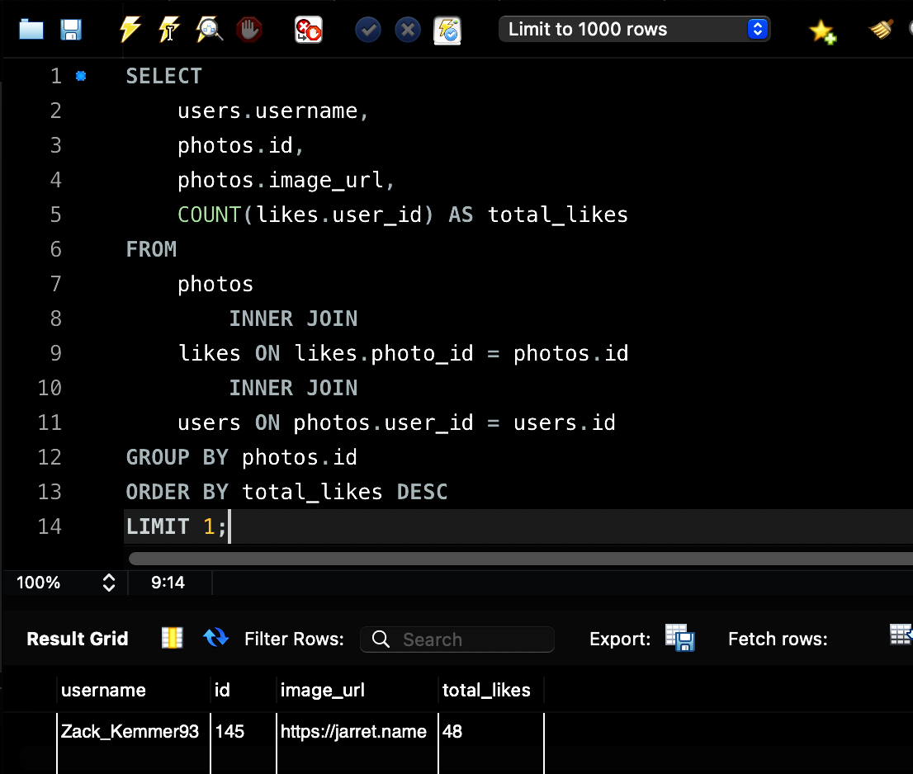
Task 3: Determine the user with the most likes on a single photo and their details to the team.
CODE:
SELECT
users.username,
photos.id,
photos.image_url,
COUNT(likes.user_id) AS total_likes
FROM
photos
INNER JOIN
likes ON likes.photo_id = photos.id
INNER JOIN
users ON photos.user_id = users.id
GROUP BY photos.id
ORDER BY total_likes DESC
LIMIT 1;
Result: Output is the data of the user with most likes on a single photo.

Slide 6
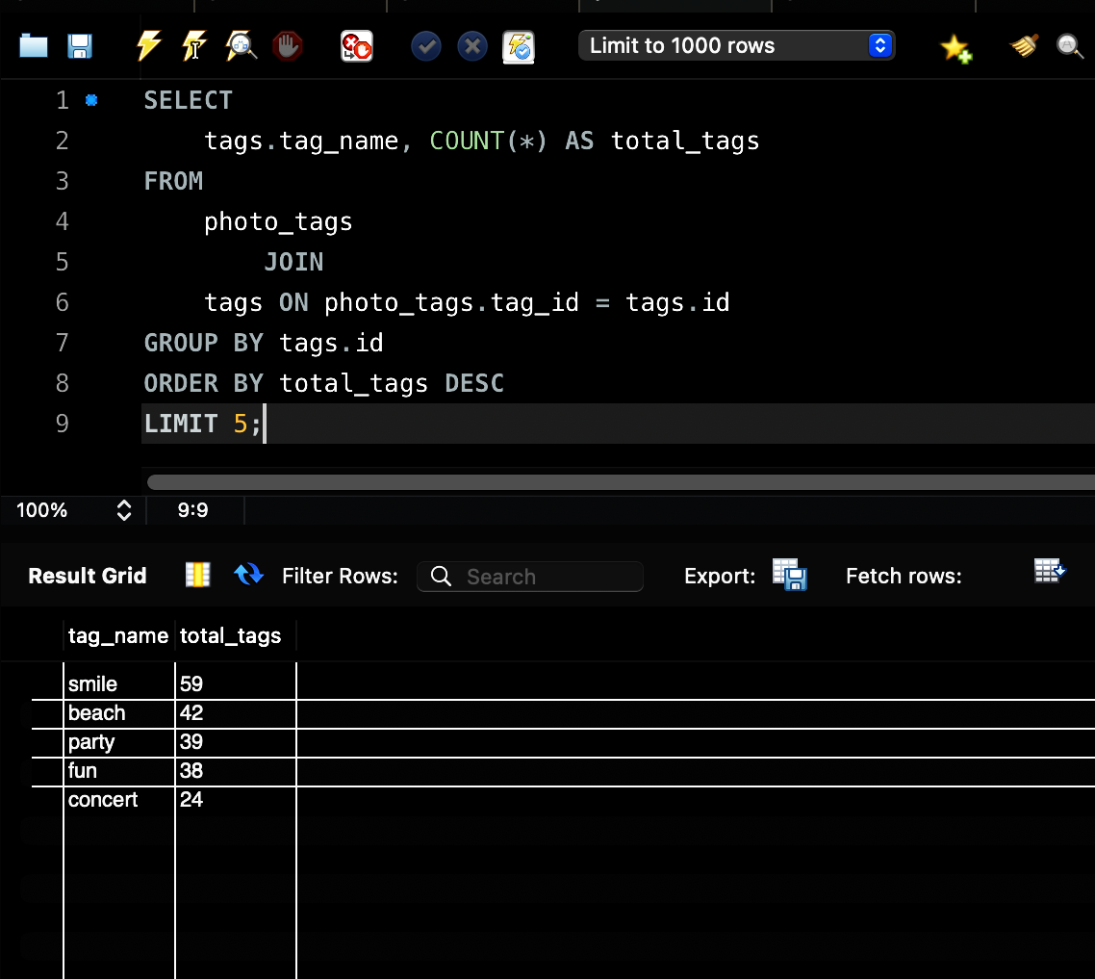
Task 4: Identify and suggest the top five most commonly used hashtags on the platform.
CODE:
SELECT
tags.tag_name, COUNT(*) AS total_tags
FROM
photo_tags
JOIN
tags ON photo_tags.tag_id = tags.id
GROUP BY tags.id
ORDER BY total_tags DESC
LIMIT 5;
Result: Output is the data of the all the top 5 most used tags by all users. It is the most relevant tags for the partner’s brand reach.

Slide 7
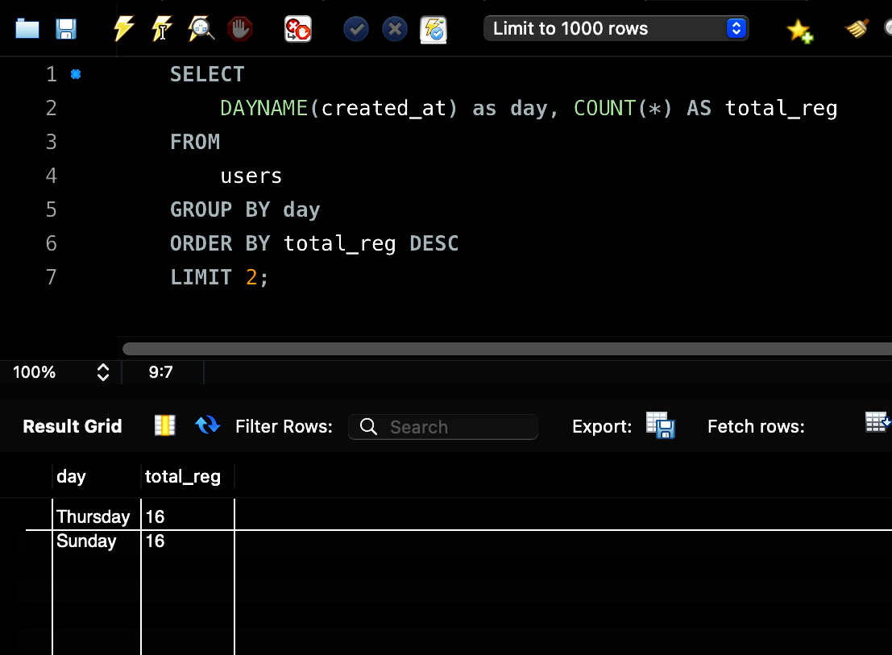
Task 5: Determine the day of the week when most users register on Instagram. Provide insights on when to schedule an ad campaign.
CODE:
SELECT
DAYNAME(created_at) as day, COUNT(*) AS total_reg
FROM
users
GROUP BY day
ORDER BY total_reg DESC
LIMIT 2;
Result: Output is the data of the days i.e, Thursday & Sunday, where most users registered on the platform is the best day to run the campaign.

Slide 8
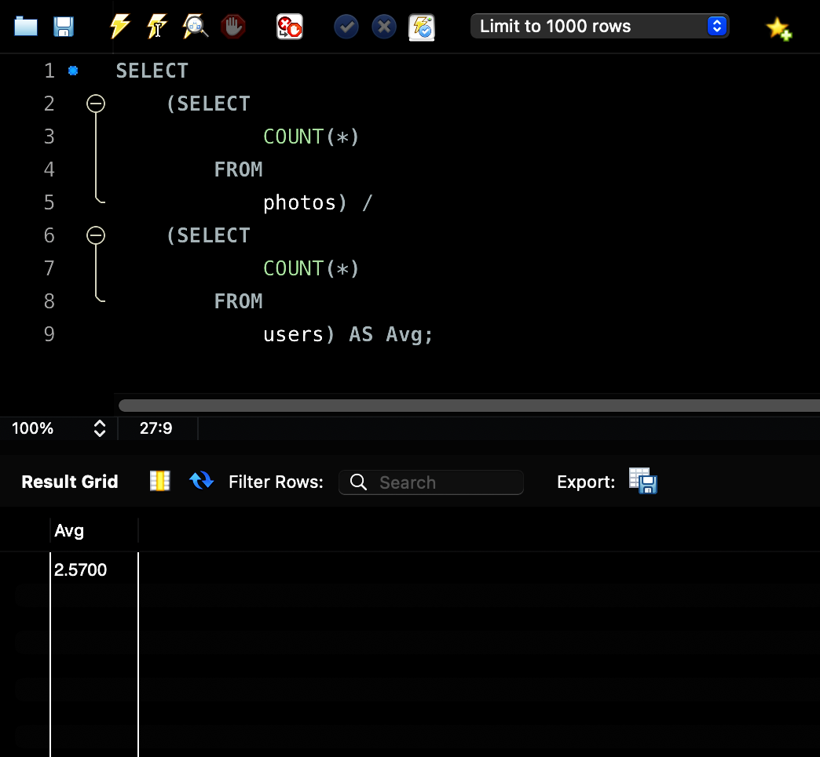
Investor Metrics:
Task 1:Calculate the average number of posts per user on Instagram. Also, provide the total number of photos on Instagram divided by the total number of users.
CODE:
SELECT
(SELECT COUNT(*) FROM photos) /
(SELECT COUNT(*) FROM users)
AS Avg;
Result: Output is the data of an Average number of posts by a single user on the Instagram platform.
Total Number of photos is 257.
Total Number of users is 100.
Hence, Average = 257/100 = 2.57.

Slide 9
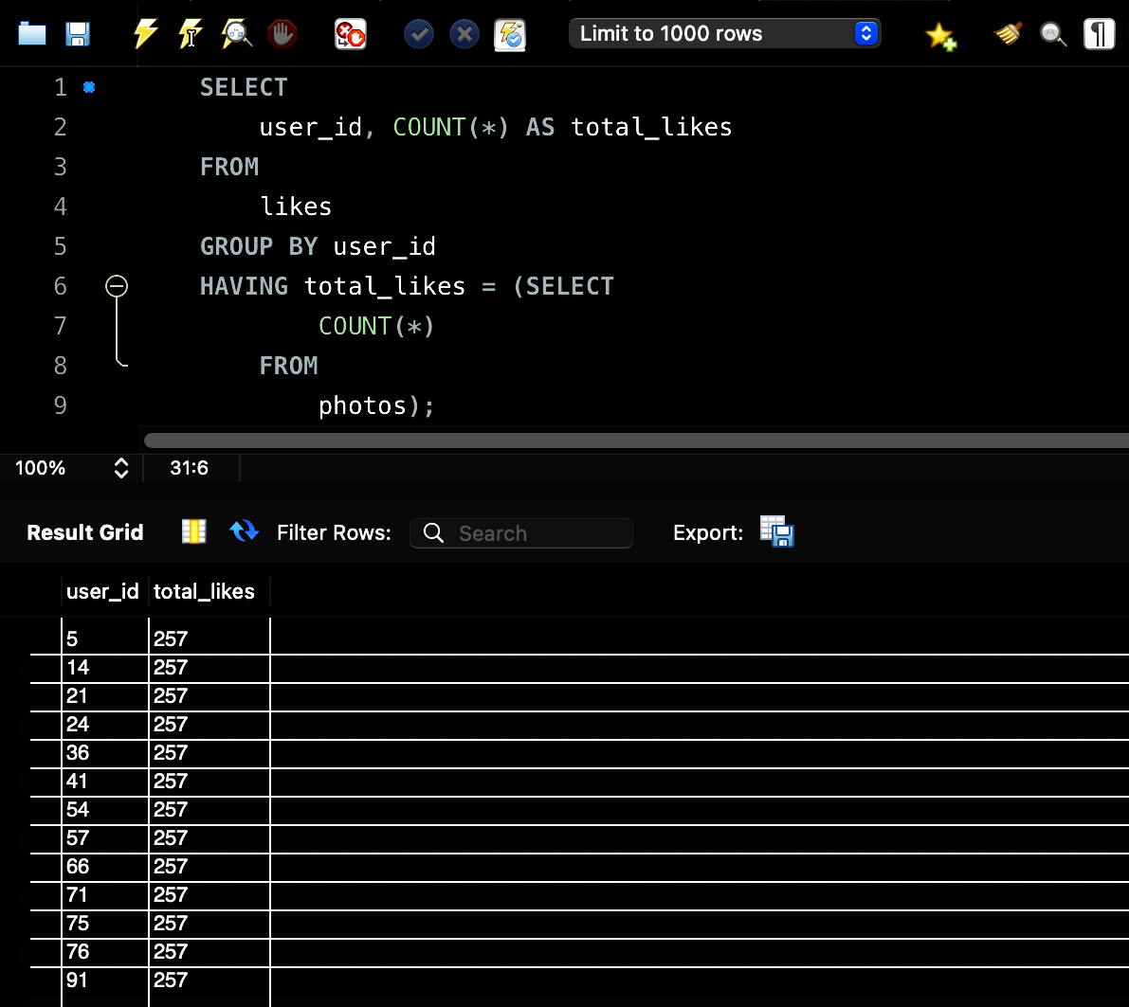
Task 2: Identify users (potential bots) who have liked every single photo on the site, as this is not typically possible for a normal user.
CODE:
SELECT
user_id, COUNT(*) AS total_likes
FROM
likes
GROUP BY user_id
HAVING total_likes = (SELECT
COUNT(*)
FROM
photos);
Result: Output is the data of all the potential bots/ dummy accounts who’s liked all the photos in the platform

Slide 10
Thank You!!

